Slide 1


Data Mining and Business Intelligence
ELECTRICITY GENERATION AND
DEMAND FORECASTING
Project By : Group 7
Anusha Derangula
Sai Bhargav Chollangi
Tharun Mahesh Palla
Urvashi Bhurase
Vishista Reddy

Slide 2


AGENDA
Problem Statement
Data S
Models
Findings & Recommendations

Slide 3
Problem Statement
Can we accurately predict the future generation and consumption of electricity in the energy market?
Objective :
The objective of this project is to forecast the generation and consumption of electricity in the energy market to ensure that the generation of electricity meets the demands.
Provide insights into the electricity supply and demand balance and avoid potential energy shortages
Goal :
Improve Decision Making around energy Policy and make efficient Resource Allocation to meet the future Demand.

Slide 4
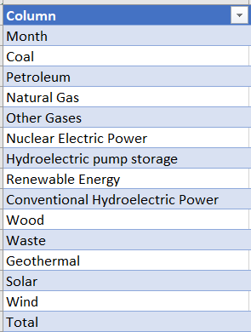
Data Source
1. Electricity Generation Dataset :
- Contains Monthly Net Energy Generation
of US from 1973 - 2022
2. Electricity Consumption Dataset :
- Contains Monthly Primary Energy consumption across sectors Residential, Commercial and Industrial.
We opted to analyze and model three variables
Renewable Energy Generation
Non-Renewable Energy Generation
Total Energy Generation

Slide 5
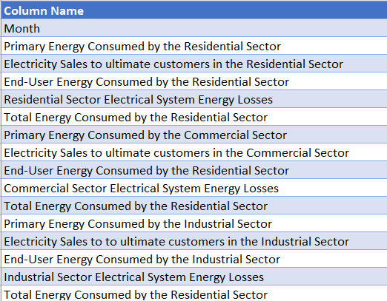
Data Source
2. Electricity Consumption Dataset : - Contains Monthly Primary Energy consumption, Total Energy consumption, End-Use energy consumption, Electricity Sales across three sectors like Residential, Commercial and Industrial.
We chose only Total End-Use of energy
Link: https://www.eia.gov/totalenergy/data/browser/index.php?tbl=T07.06#/?f=M&start=197301&end=202210&charted=5-6-

Slide 6
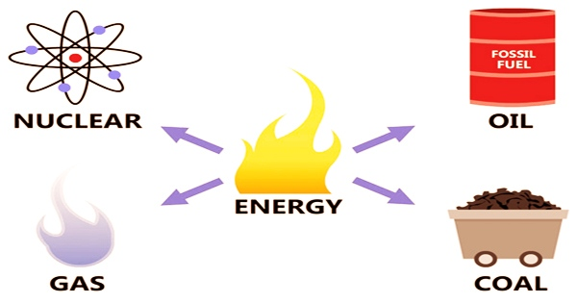
NON RENEWABLE RESOURCES

Slide 7
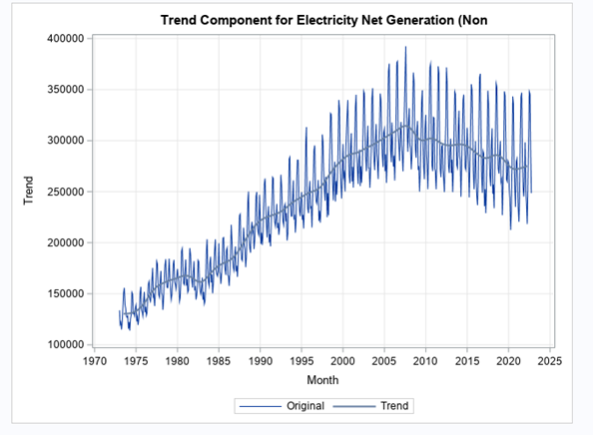
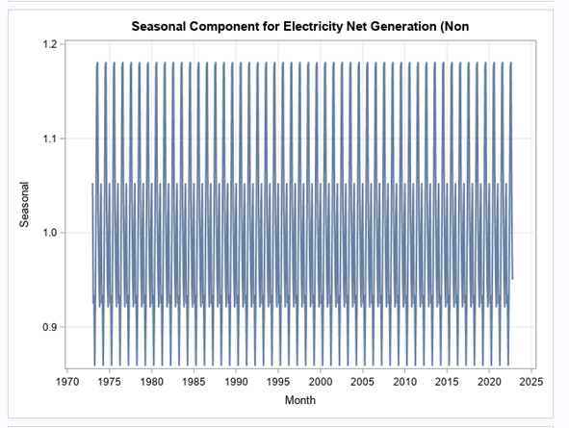
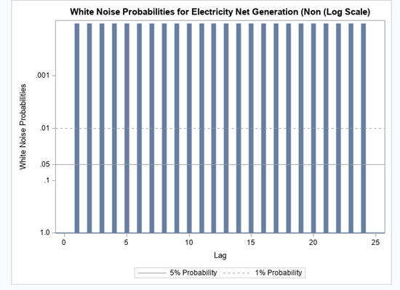
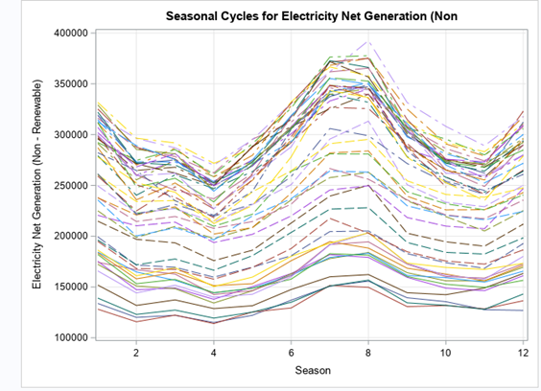
Time series forecasting for non renewable resources

Slide 8
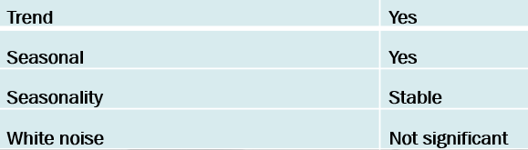
Time series forecasting for non renewable resources

Slide 9
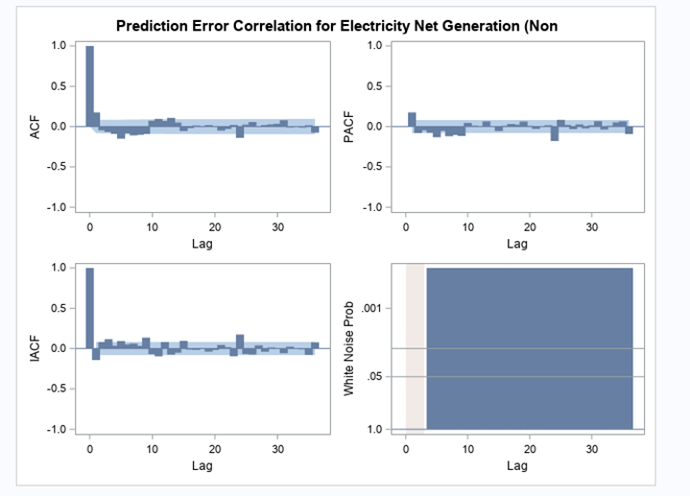
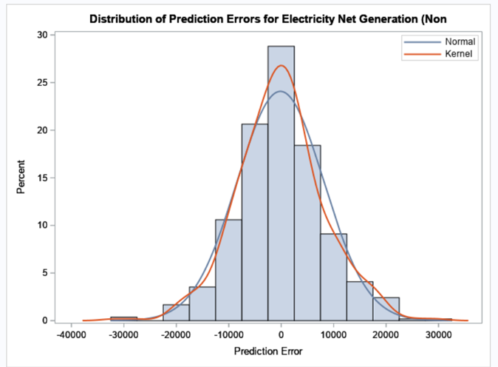
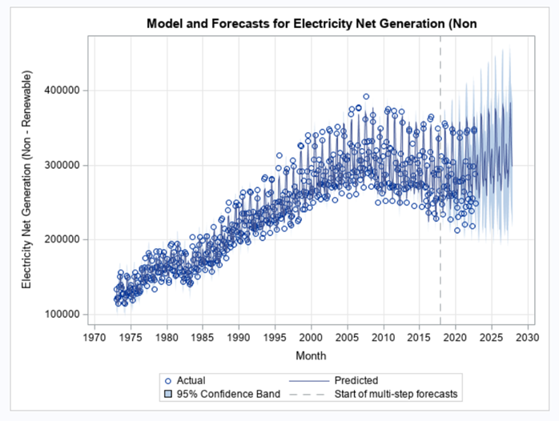
Winter additive model

Slide 10
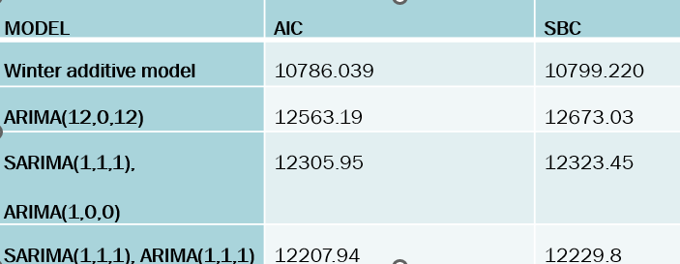
Model Comparison

Slide 11
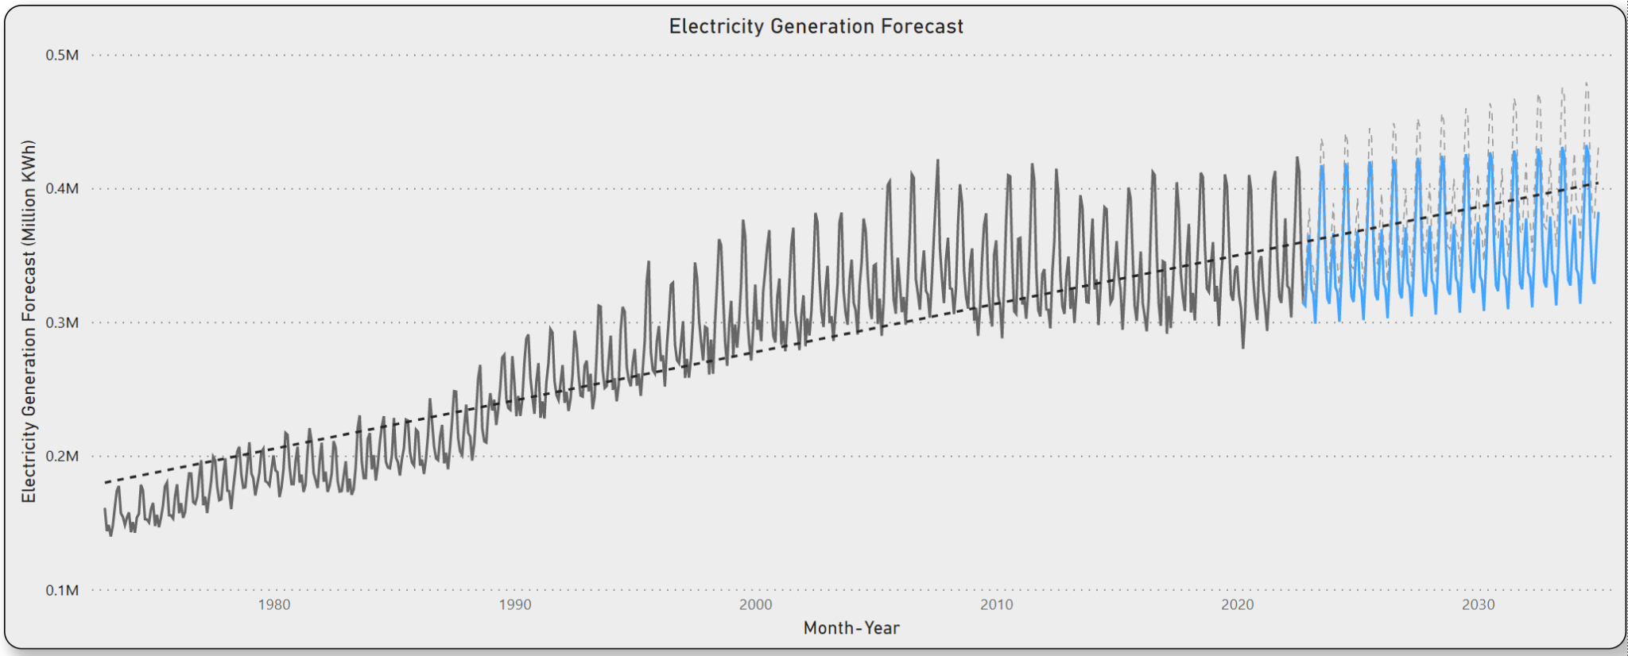
Total Electricity Generation Forecast Till 2034

Slide 12
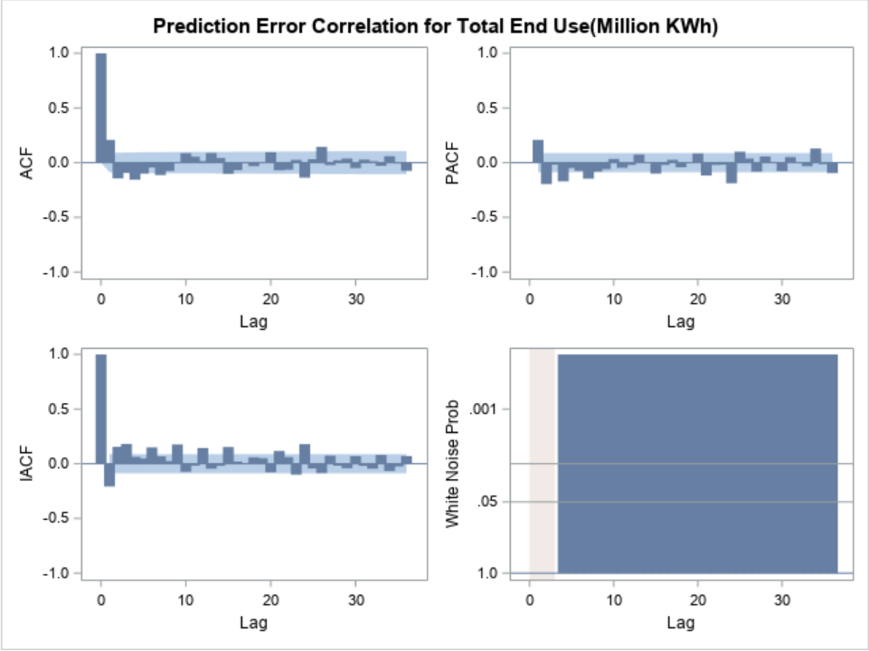
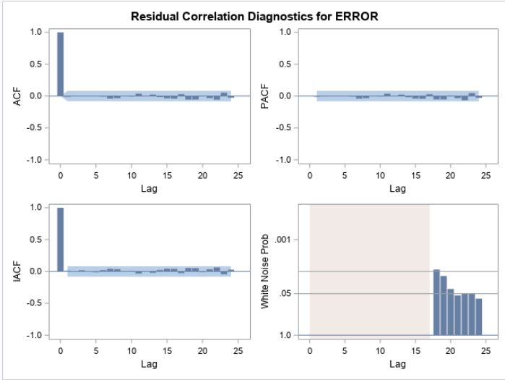
Electricity End Use

Slide 13
Electricity End Use

Slide 14
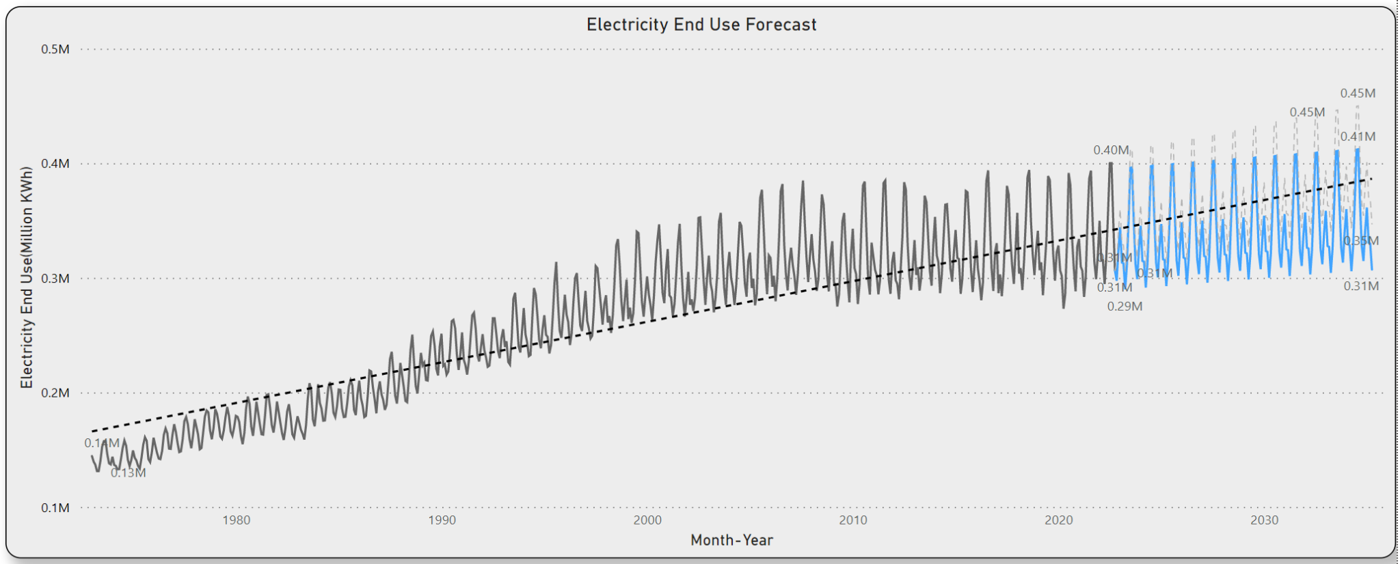
Electricity End Use Forecast Till 2034

Slide 15
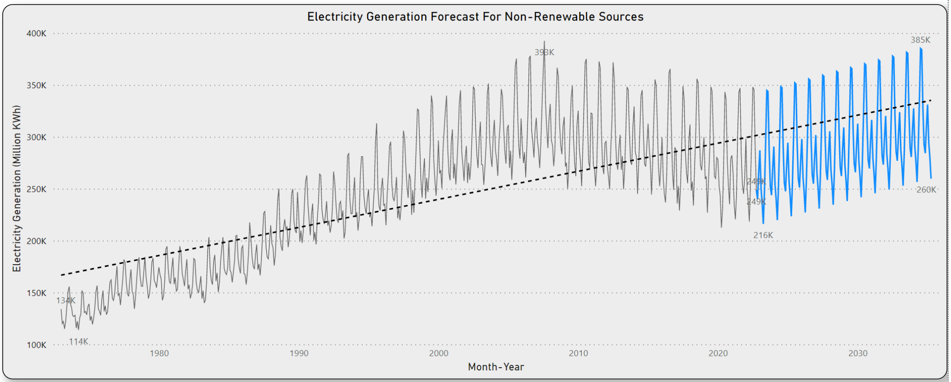

Slide 16
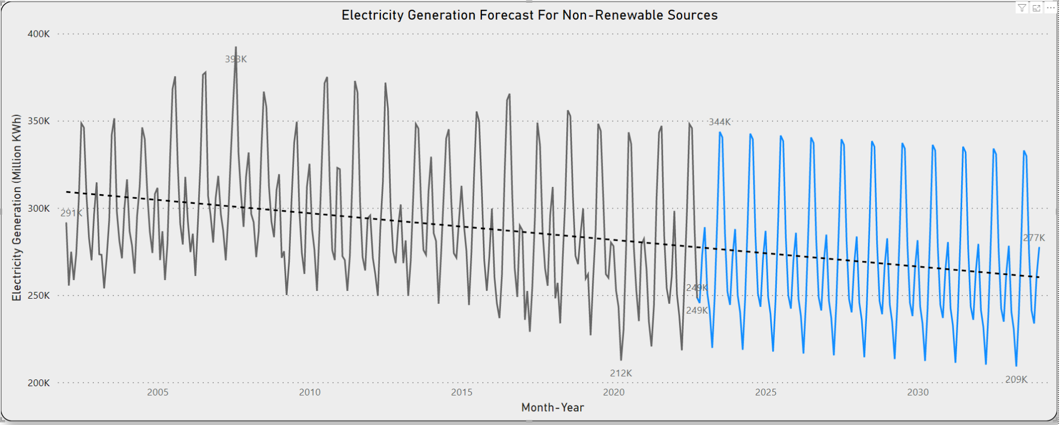

Slide 17
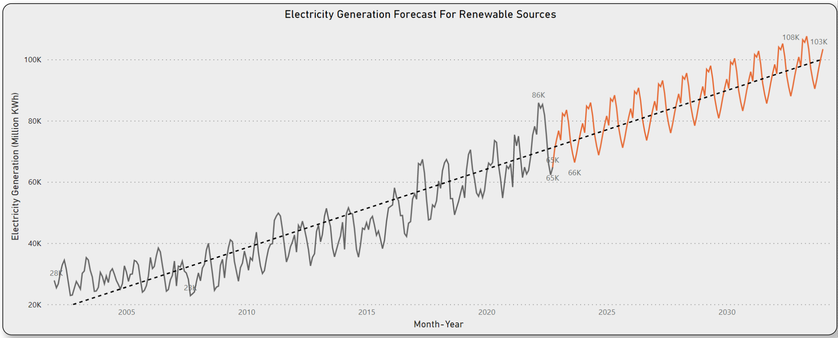

Slide 18
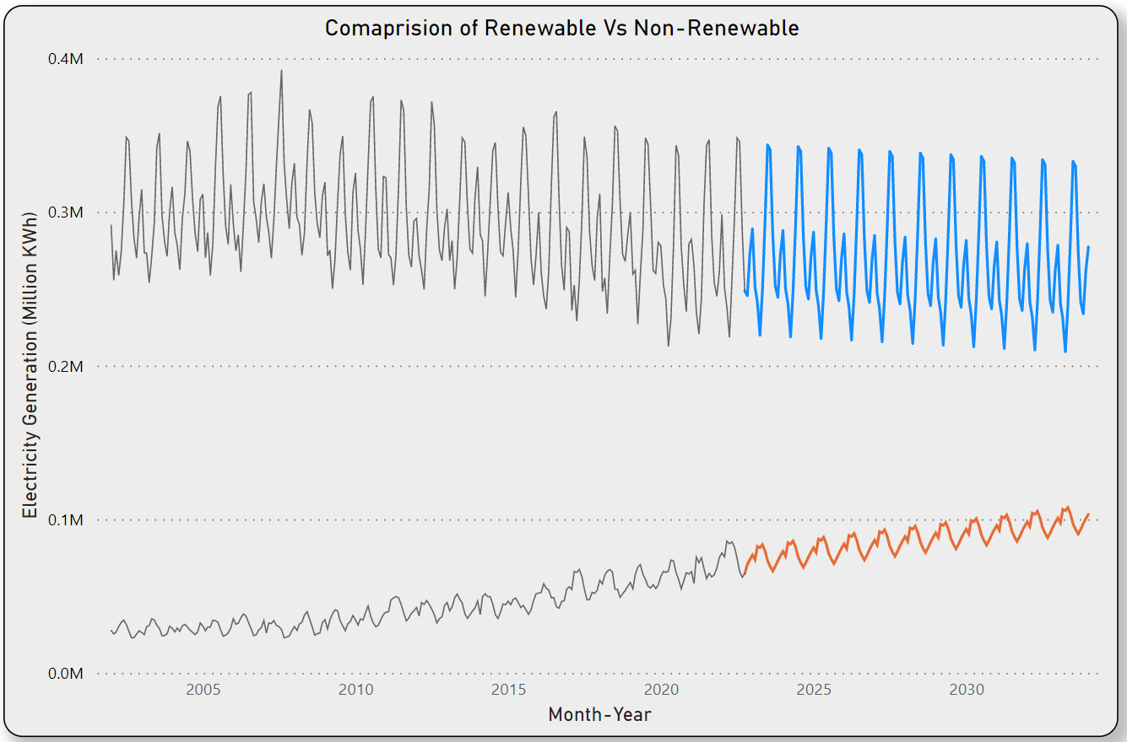

Slide 19
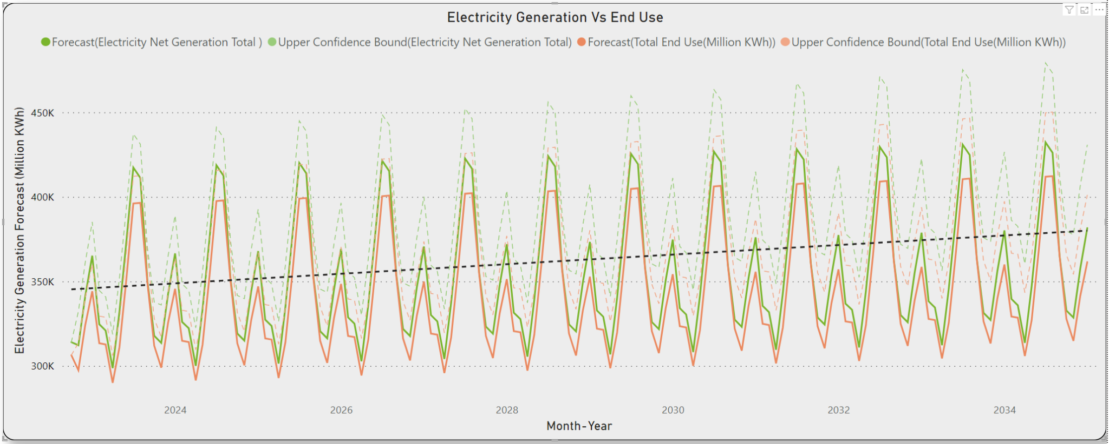

Slide 20
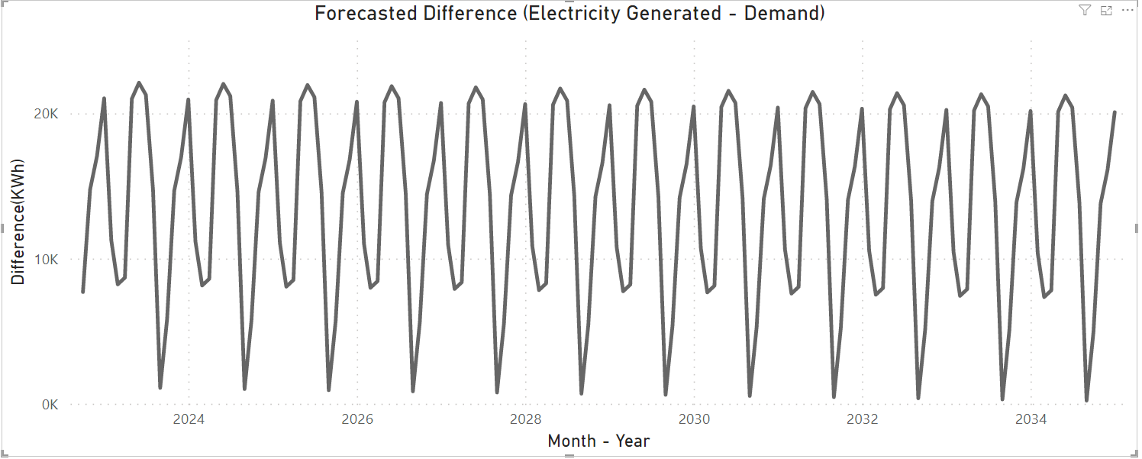

Slide 21
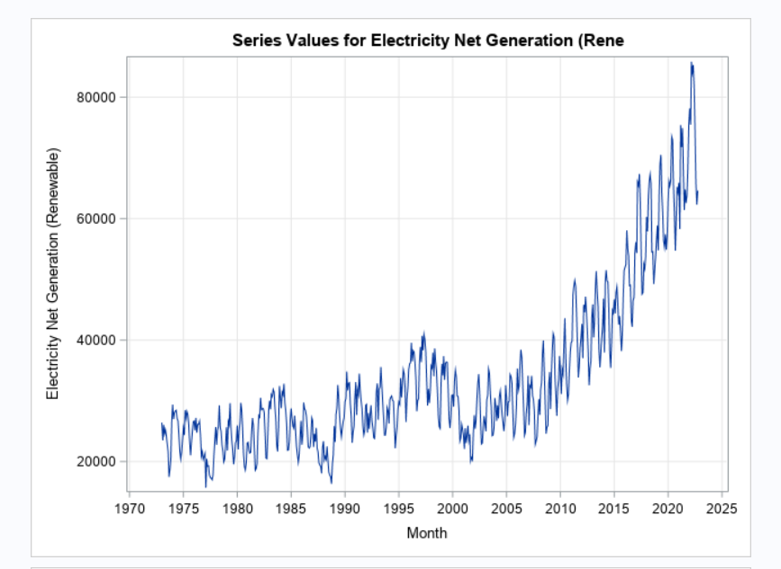
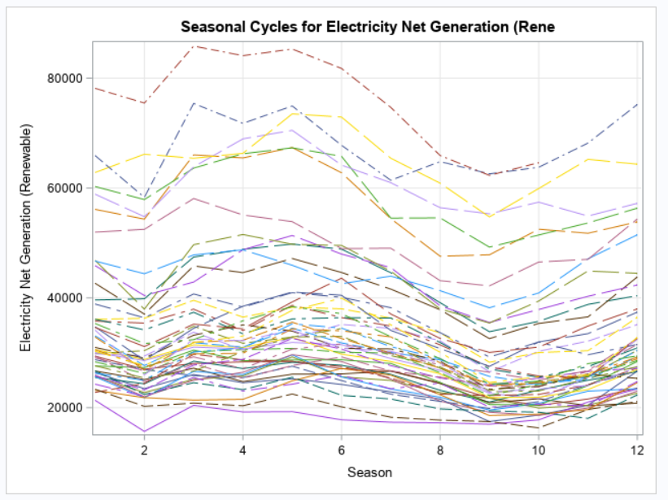
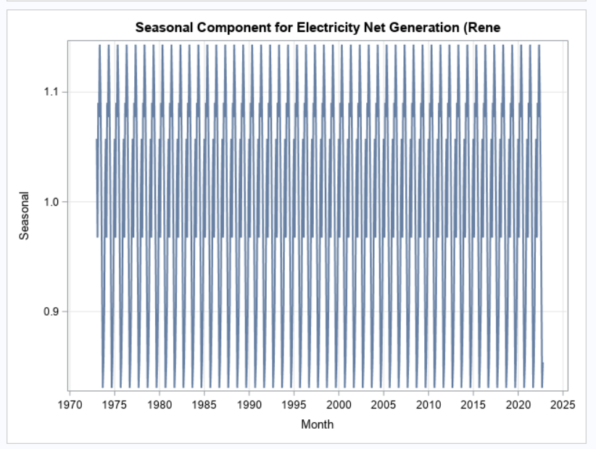
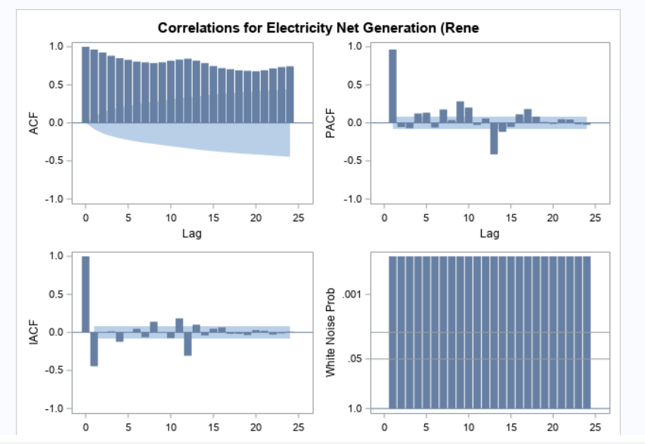
Time Series Forecasting of Renewable Resources
Decomposition Analysis

Slide 22
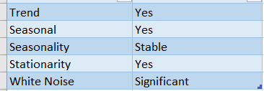

Slide 23
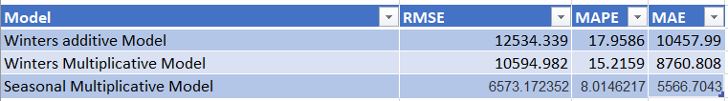

Slide 24
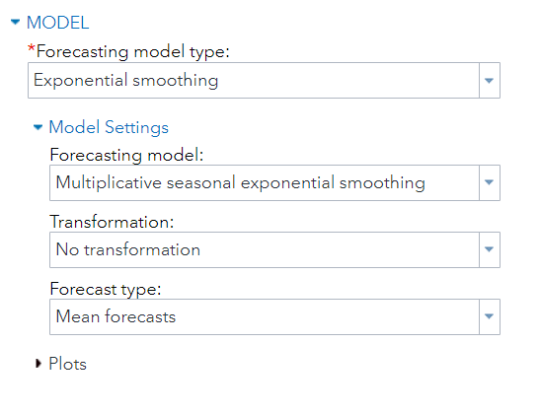
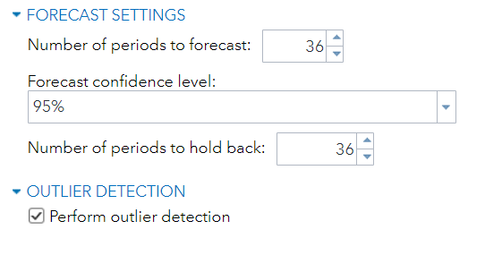
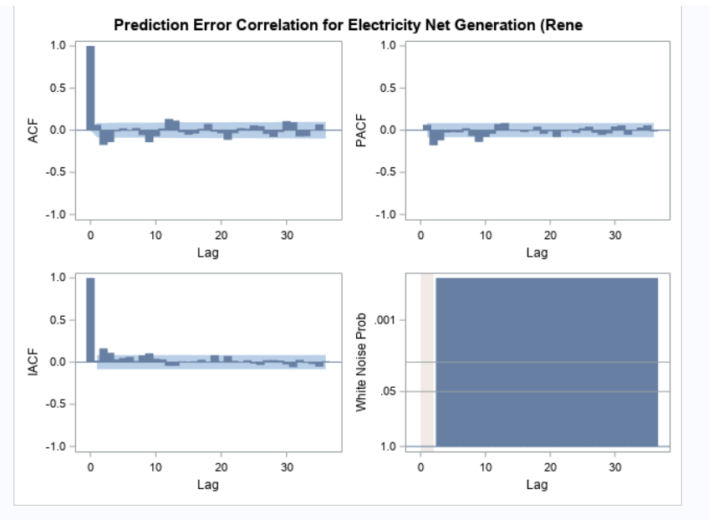
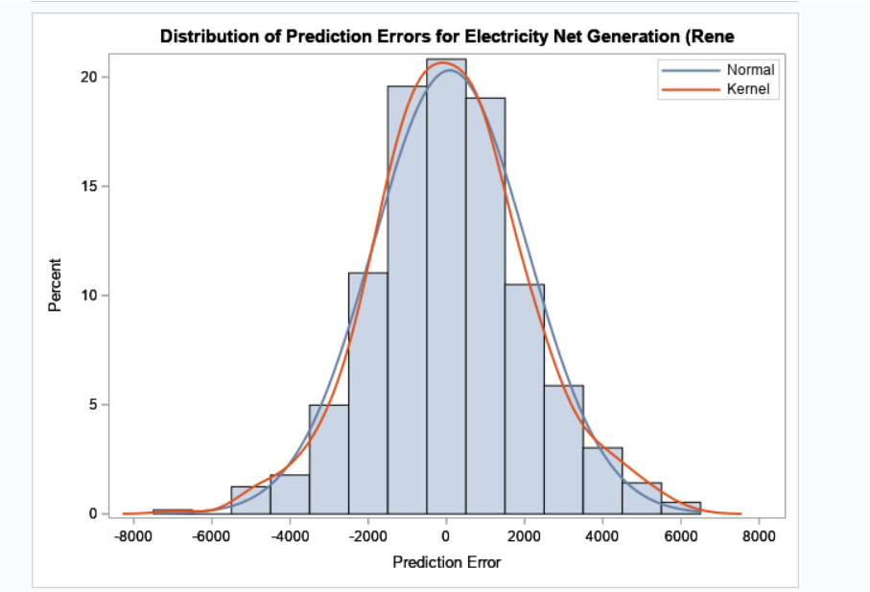

Slide 25
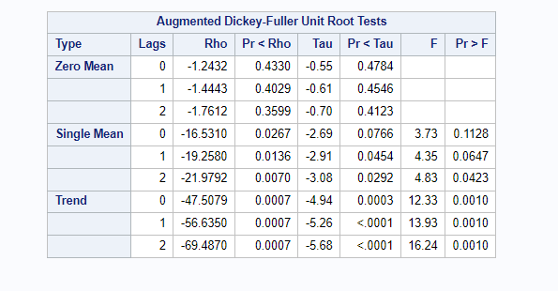

Slide 26
Model | RMSE | MAPE | MAE | AIC | SBC
Seasonal Multiplicative Model + SARIMA(3,0,3) | 6573.172352 | 8.01462173 | 5566.704268 | 10928.22407 | 10958.9792

Slide 27
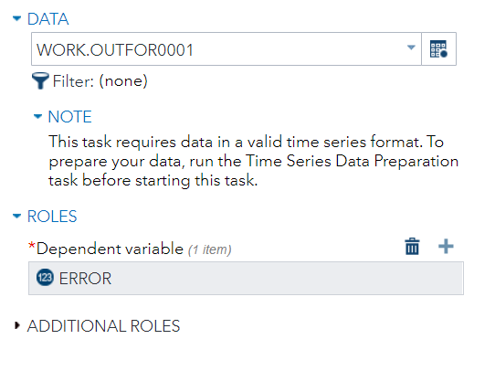
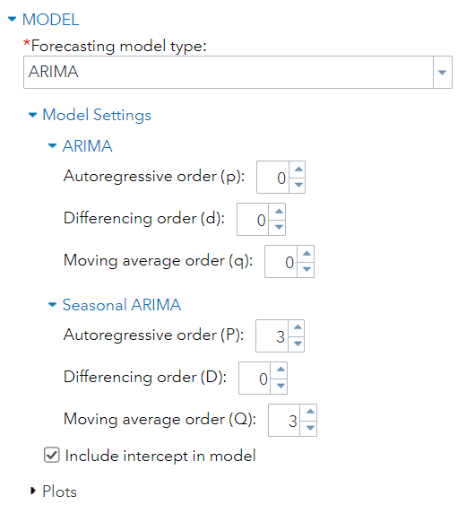
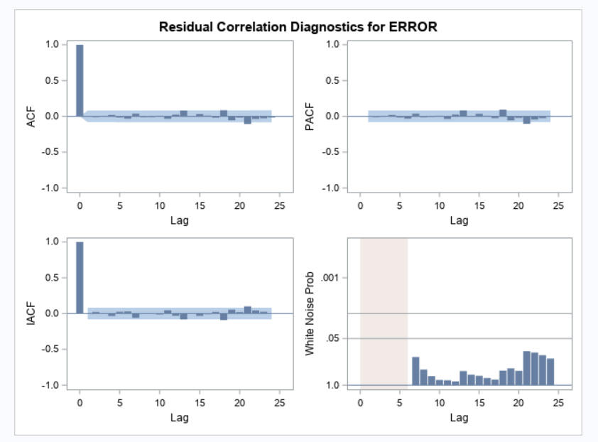
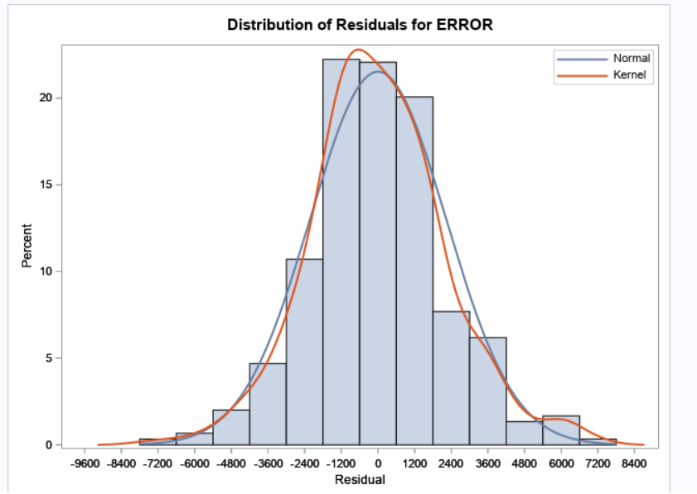

Slide 28



